Slide 1




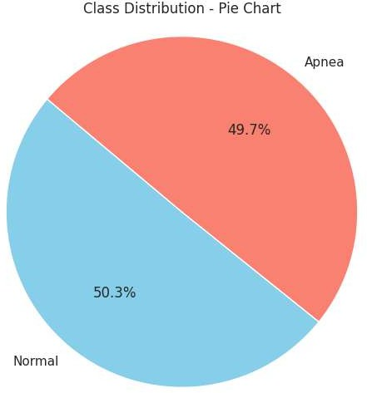
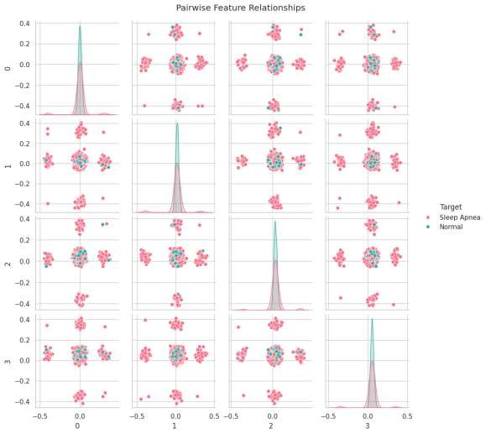
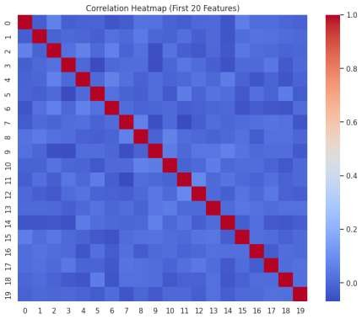
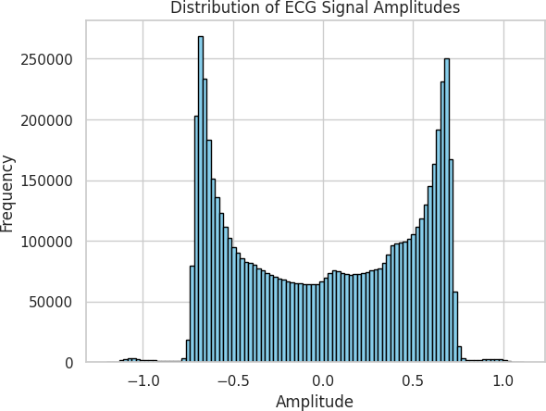
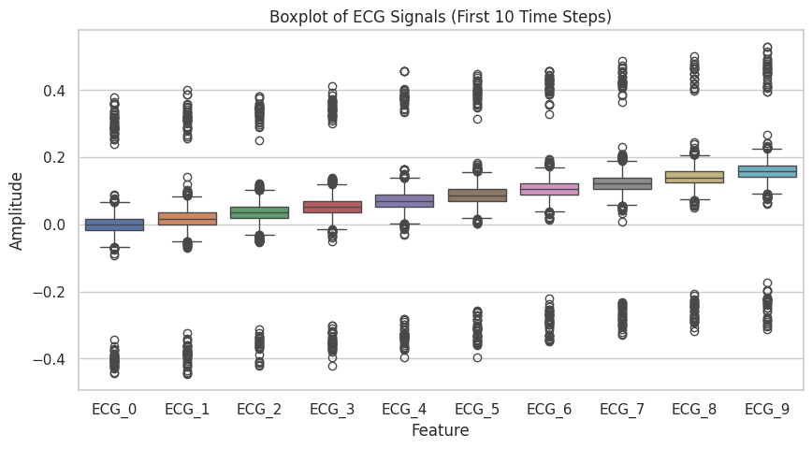
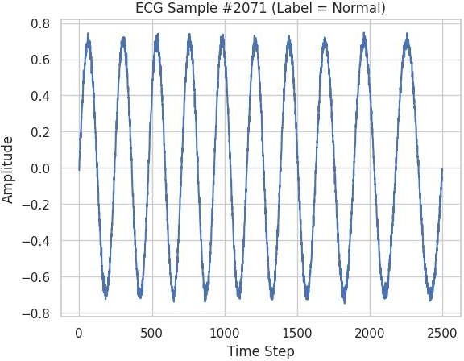
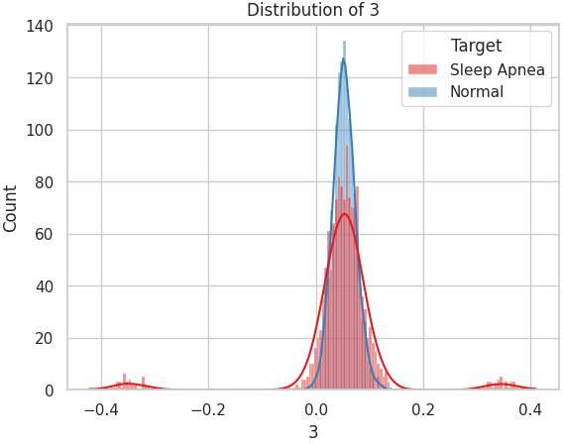
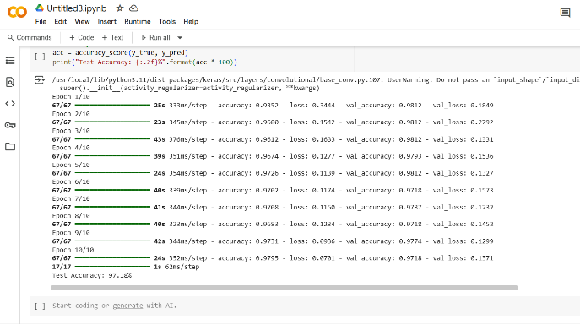
Detection of Sleep Apnea using 1D CNN-BiLSTM
STUDENT NAME:SAMPURNAA NAG (12024052016005) STUDENT NAME: SYLVIA BARICK (12024052016009}
STUDENT NAME:DEBOJYOTI DE MAJUMDER(12024052020010)
Team Name: CodeTrio
Introduction
Our Approach
Discussion
Conclusion and Future Scope
Sleep apnea is a serious sleep disorder that results in excessive pauses in breathing and leads to disrupted sleep or low levels of blood oxygen. It is typically diagnosed with polysomnography (PSG) procedure, however, limited access to the ECG in clinical settings presents a barrier. Recent advances with deep learning have allowed for automated and non-invasive methods to detect sleep apnea using physiological signals from an electrocardiogram (ECG) recording. With ECG signals being complex high-dimensional, non- stationary signals, we use a hybrid deep-learning approach for detection of sleep apnea. We use 1D-CNN layers to extract local spatial features as well as BILSTM layers to capture long-term temporal dependencies, and utilize an attention mechanism for improvements. Overall, not only does this improve the accuracy of our detection system, it also provides an interpretable model for clinical settings making it applicable in a real-world context.
Methodology:
Data Preprocessing: We processed the Apnea-ECG dataset, in which the ECG signals underwent
preprocessing with a Chebyshev bandpass filter (0.5-48 Hz) to minimize noise. The signals were divided into windows of 1 minute, and segments that were categorized as noisy (approximately 5% of the data) were discarded automatically based on a measure of similarity using autocorrelation.
Model Architecture:
Using a combination of CNN and BiLSTM layers with an attention mechanism was a
key factor in increasing accuracy in detection. Discussion below includes:
In summary, the suggested 1D-CNN-BILSTM model with an attention mechanism has proven to be highly accurate in identifying sleep apnea from ECG signals, achieving training accuracy of 95.79% and validation accuracy of 93.62%. This research opens the door for deeper learning-based methods to be installed in real-time systems with the hope of early identification of sleep apnea.
Future Scope:
Hierarchy of Feature Extraction: The multi-layered CNN strategy captures low-level features and high-level features progressively through the layers of the CNN architecture and key components of the ECG waveform.
Transactional Dependence: The BILSTM layers use both past and future timesteps to capture key information that is essential for capturing the gradual onset of apnea.
Overfitting and Generalization: Strategies such as Dropout and adaption for learning rates prevent overfitting and subsequently allow for improved generalization on validation data.
Interpreting the Model: The attention layer improves the accuracy of classification but also elucidates what parts of the ECG signal have the greatest weight on detecting sleep apnea.
Multi-Signal integration: Some physiological signals (eg., respiration, SpO₂) can
be incorporated to enhance accuracy, as well.
Model Optimization: transformer-based models or more advanced ensemble approaches need to be explored to enhance performance and utilize lower power.
Clinical Validation: testing should be expanded to clinical trials and apply the model to portable monitoring devices.
Explainability: to further support clinical practitioners, we should advance explainability techniques.
CNN Layers: Three 10 convolution blocks using ReLU activation and batch normalization were used to pull hierarchical spatial features from the raw ECG signals.
BILSTM Layers: The model includes two BiLSTM layers containing 128 and 64 units, respectively. to capture geospatial dependencies in the time series across time for past and future context.
Attention Mechanism: An attention layer was added to the model to weight the time steps in order to preferentially highlight the time segments with the most relevance for apnea events.
Fully Connected Layers: The final feature representations were provided to one or more dense layers before the final output layer produced the classifications of normal or sleep apnea utilizing the sigmoid activation function.
The findings substantiate the model's applicability within clinics as a low-cost, non- invasive screening for sleep apnea
References
Zarei, A., Beheshti, H., & Asl, B. M. (2022). Detection of sleep apnea using deep neural networks and single-lead signals. Biomedical Signal Processing and Control, 71, 103125.
Bahrami, M., & Forouzanfar, M. (2022). Sleep apnea detection from single-lead ECG: A comprehensive analysis of machine learning and deep learning algorithms. IEEE Transactions on Instrumentation and Measurement, 71, 1–9.
Mendonça, F., Mostafa, S. S., Ravelo-García, A. G., Morgado, E., Penzel, T., & de la Torre Díez, I. (2018). A review of obstructive sleep apnea detection approaches. IEEE Journal of Biomedical and Health Informatics, 23(2), 825– 837.
Zarei, A., & Asl, B. M. (2020). Automatic classification of apnea and normal subjects using new features extracted from HRV and ECG-derived respiration signals. Biomedical Signal Processing and Control, 59, 101927.
Nguyen, H. D., Nguyen, H. T., & Andrew, A. M. (2013). An online sleep apnea detection method based on recurrence quantification analysis. IEEE Journal of Biomedical and Health Informatics, 18(4), 1285–1293.
Khandoker, A. H., Palaniswami, M., & Karmakar, C. (2008). Support vector machines for automated recognition of obstructive sleep apnea syndrome from ECG recordings. IEEE Transactions on Information Technology in Biomedicine, 13(1), 37–48.
Mendez, M. O., Bianchi, A. M., Matteucci, M., Cerutti, S., & Penzel, T. (2009). Sleep apnea screening by autoregressive models from a single ECG lead. IEEE Transactions on Biomedical Engineering, 56(12), 2838–2850.
Erdenebayar, U., Lee, H., & Kim, Y. (2019). Deep learning approaches for automatic detection of sleep apnea events from an electrocardiogram. Computer Methods and Programs in Biomedicine, 180, 105001.
Dey, D., Chaudhuri, S., & Munshi, S. (2018). Obstructive sleep apnoea detection using convolutional neural network-based deep learning framework. Biomedical Engineering Letters, 8(1), 95–100.
Training:
We trained the model using the Adam optimizer over 150 epachs (with a learning rate of 0.0011 Incorporated gradient clipping in the loss function, along with dropout in the range of 20%-40% as a regularization method to reduce overfitting, where performance was tracked by binary cross-entropy loss and accuracy.
Objectives and Challenges
Objectives
Automated Detection: Create a strong model for automatically detecting sleep apnea using raw ECG signals.
Feature Extraction: Efficiently extract spatial (using CNN) and temporal (using BILSTM) features to capture subtle changes related to apnea.
Model Generalization: Show high accuracy and reliability on unseen data using dropout regularization and attention
Real-Time Application: Begin the integration Into portable, non-invasive devices for use in continuous sleep
Objectives
Automated Detection: Create a strong model for automatically detecting sleep apnea using raw ECG signals.
Feature Extraction: Efficiently extract spatial (using CNN) and temporal (using BILSTM) features to capture subtle changes related to apnea.
Model Generalization: Show high accuracy and reliability on unseen data using dropout regularization and attention
Real-Time Application: Begin the integration Into portable, non-invasive devices for use in continuous sleep
Test Accuracy: 97.18%
monitoring.
monitoring.

